Slide 1

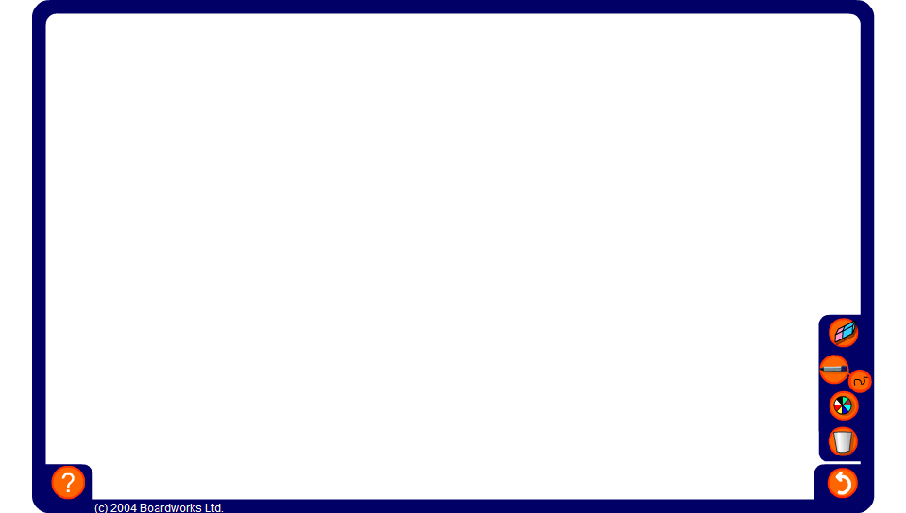


Mixed addition square
Notes:
Work out the numbers in the empty squares by adding and subtracting.
Ask pupils why we do not need to label the sides of the square ‘first number’ and ‘second number’ (it makes no difference if we add 3 + 7 or 7 + 3).

